Slide 1
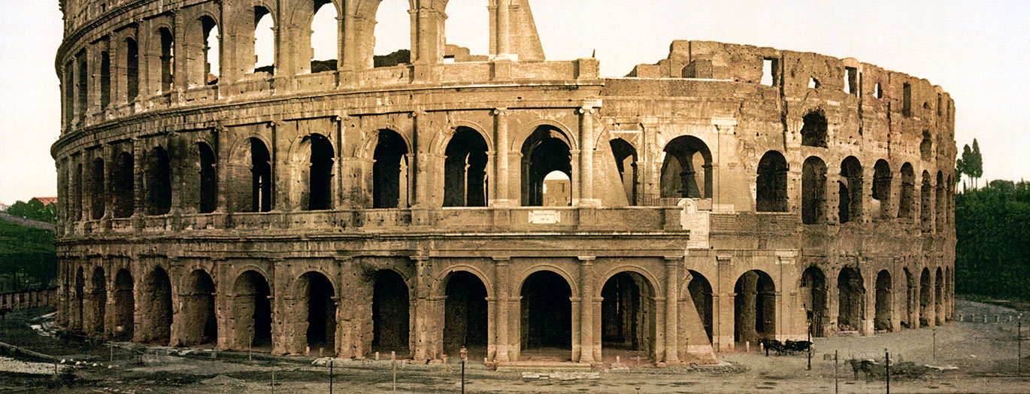
[School Name]
*you can replace this image with the image on your quote*
[Trip Destination], [date]

Slide 2
What are we here to talk about?
Where, when and why are we going?
How much and who can go?
What are we going to see and do?
Where are we staying?
How are school trips beneficial?
Who’s our tour operator?
Any questions?

Slide 3
Where, when and why are we going?
Where?
[Destination]
When?
[Dates, departure and return times?]
Why?
[Aim of the tour]

Slide 4
How much and who can go?
How much?
Who can go?
£…
This includes:
Return transportation by air/coach
… nights’ full-board/half-board/room only accommodation
Travel insurance
Visits and entrance fees?
Group passport?
Itinerary planning service
E.g. ‘This trip is open to all Year 10 history students.’

Slide 5
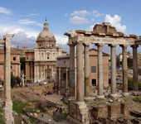
What are we going to see and do?
1 slide per visit/attraction
Use the text and images from your quote destination guide or create your own description

Slide 6
What are we going to see and do?
e.g. Roman Forum
The forum was the centre of political, commercial and judicial life in ancient Rome. The largest buildings were the basilicas, where legal cases were heard.
It emerged as such in the 7th century BCE and maintained this position well into the Imperial period, when it was reduced to a monumental area.
It was mostly abandoned at the end of the 4th century.

Slide 7
Where are we staying?
Provide details on your accommodation
Use the text and images from your quote and destination guide or create your own description

Slide 8
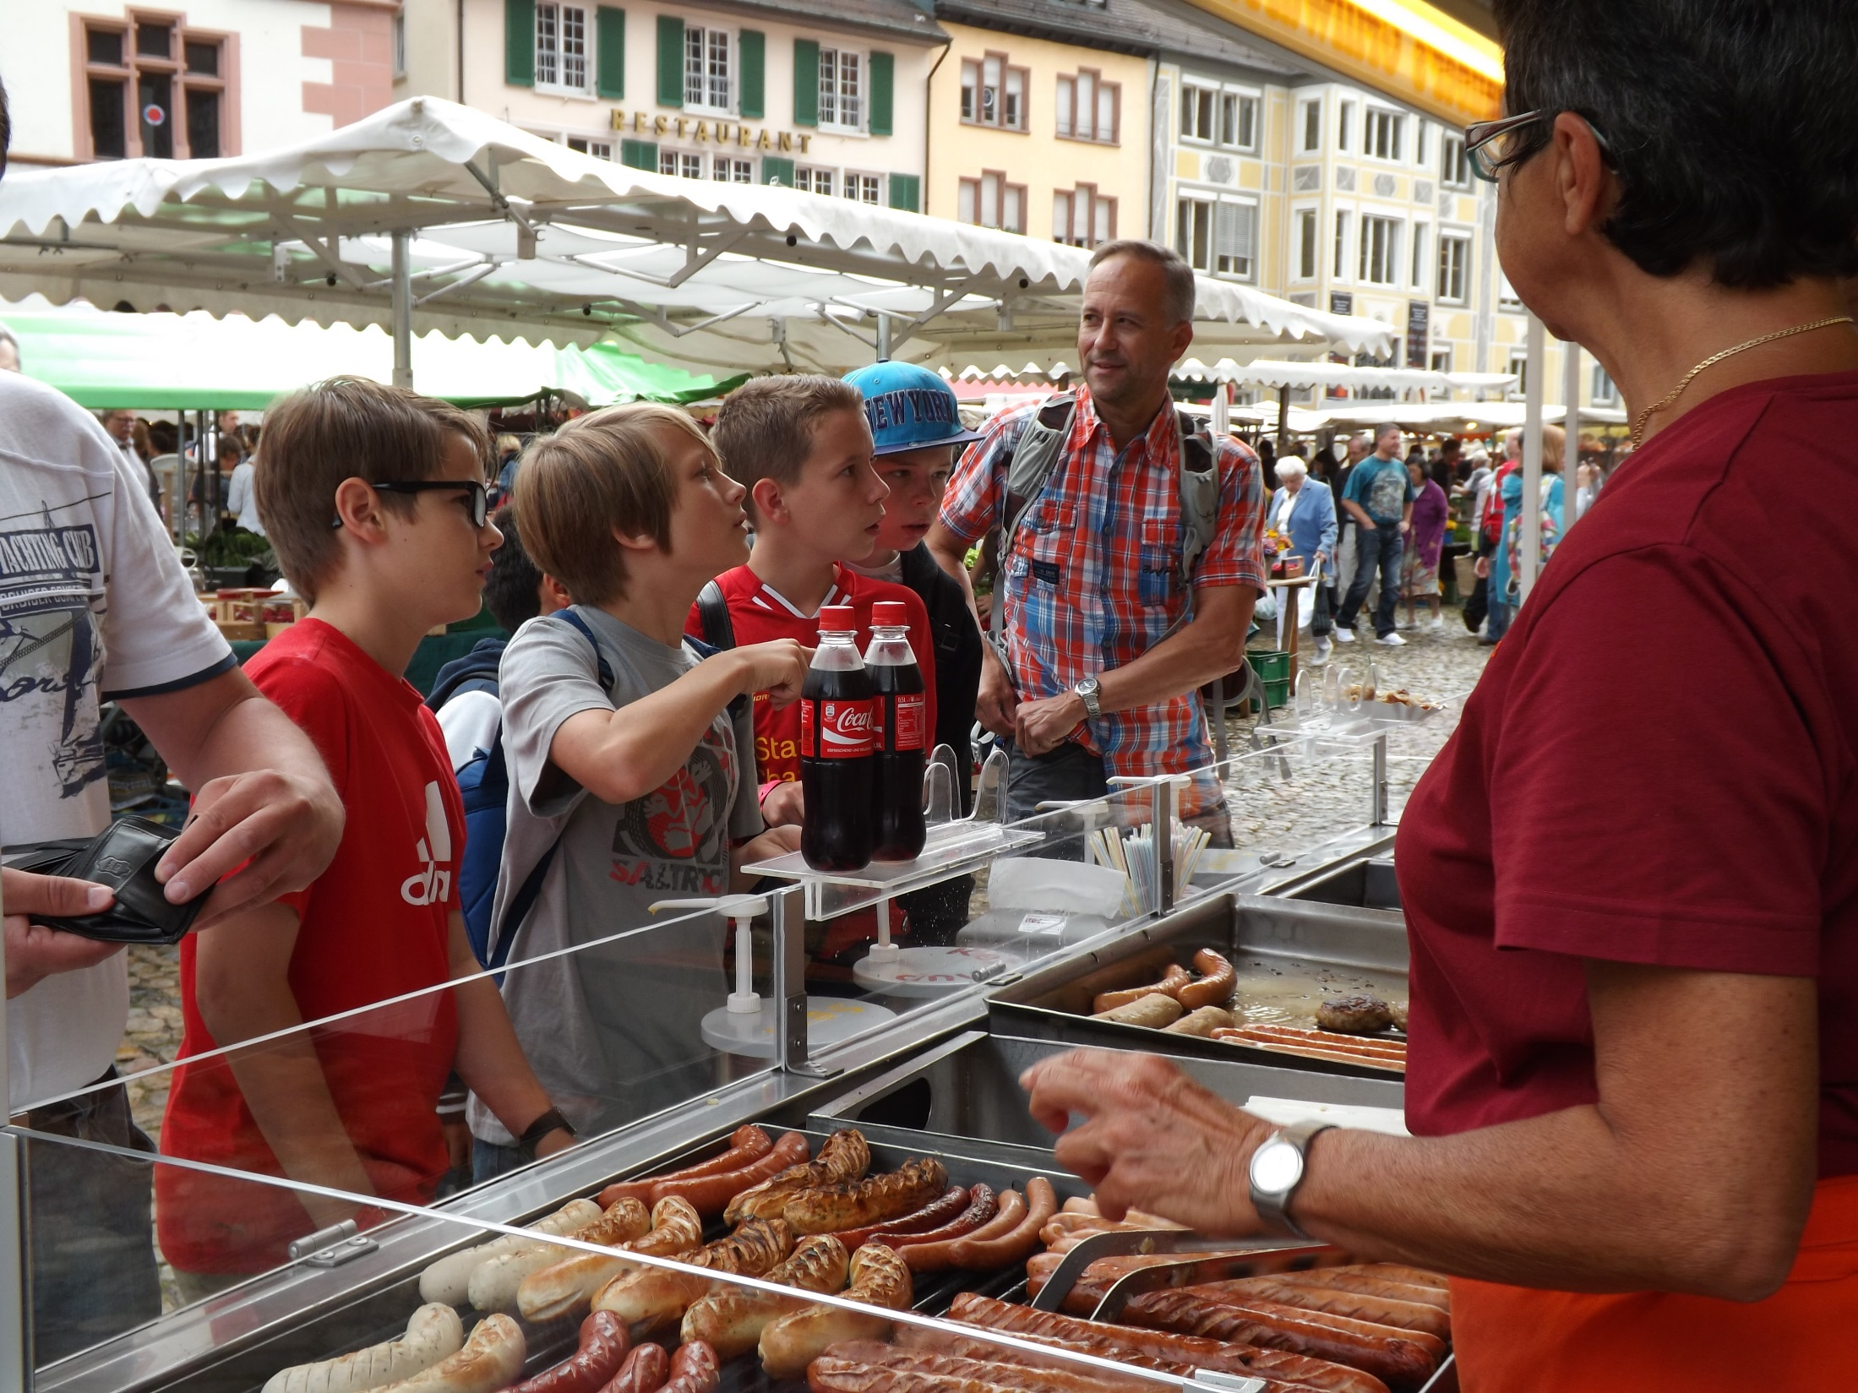
What are the benefits of school trips?
“When planned and implemented well, learning outside the classroom contributed significantly to raising standards and improving pupils’ personal, social and emotional development.”
Ofsted, LOtC: how far should you go? 2008

Slide 9
A school trip has many benefits

Slide 10
Reinforcement
By seeing for themselves what they’ve been learning about in class, students will gain a better, deeper understanding of the topic.

Slide 11
Reinforcement
“Wide-ranging out-of-classroom activities, including school trips, are cited as examples of outstanding teaching. Students are able to appreciate their studies from a different, and usually more active, perspective. Trips to Berlin and the battlefields of Belgium are named as examples.”
Ofsted, History for all, 2011

Slide 12
Higher achievement in exams
A school trip gives students practical memories to draw on during exams.

Slide 13
Improved relationships
By escaping the everyday confines of the classroom, and sharing new experiences, students can build trust and respect with each other, and also with their teacher.

Slide 14
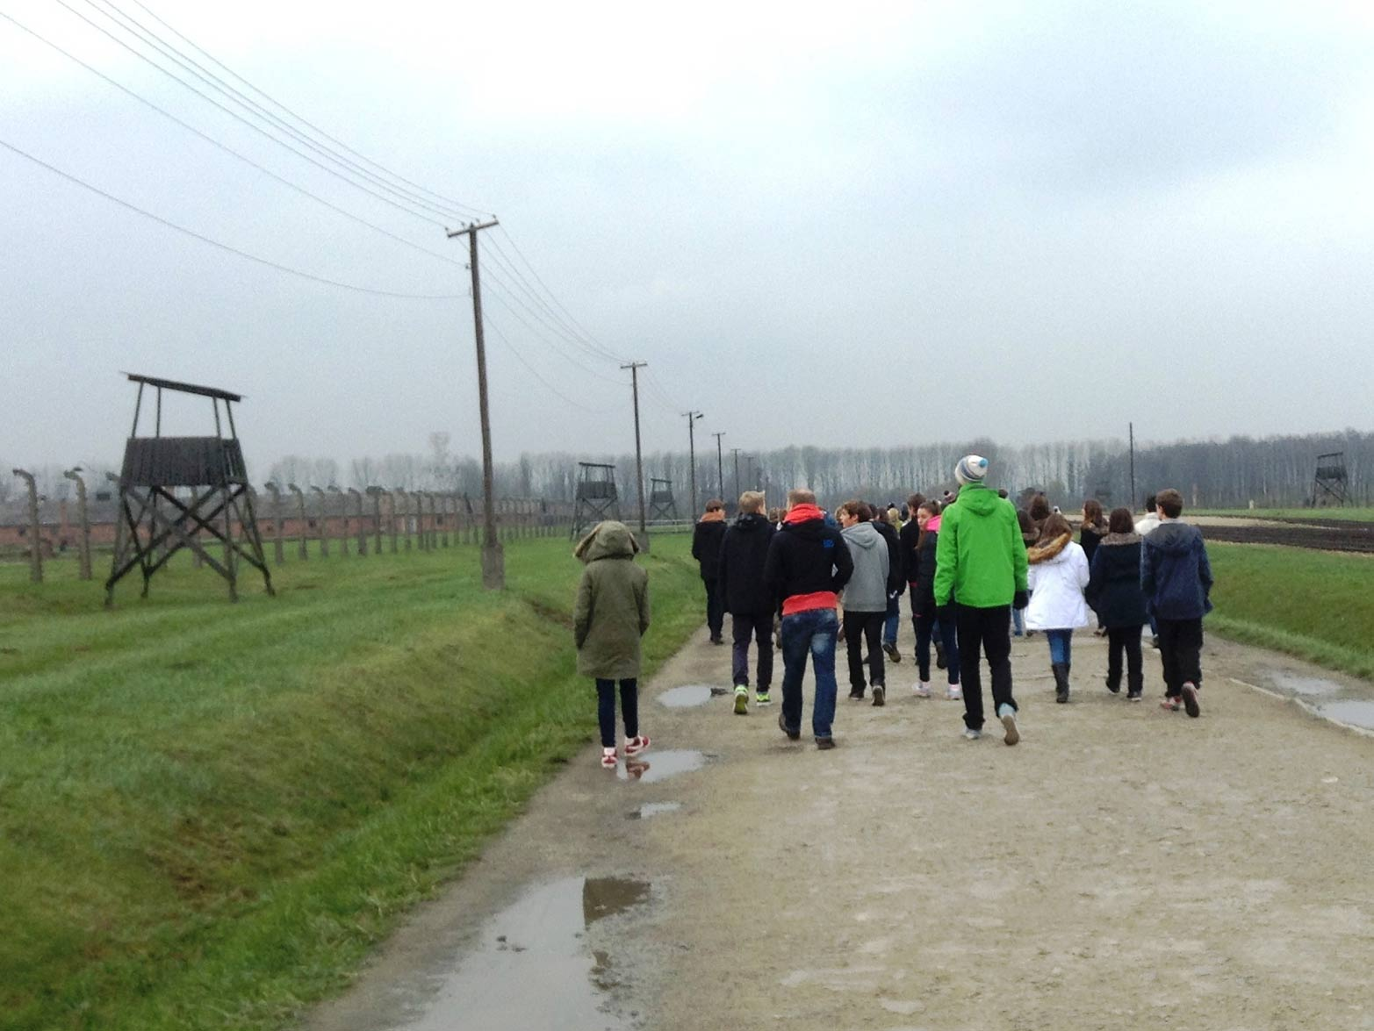
Higher engagement
The opportunities that school trips offer to embrace different learning styles means that those that prefer more visual or tactile methods will engage more in the learning.

Slide 15
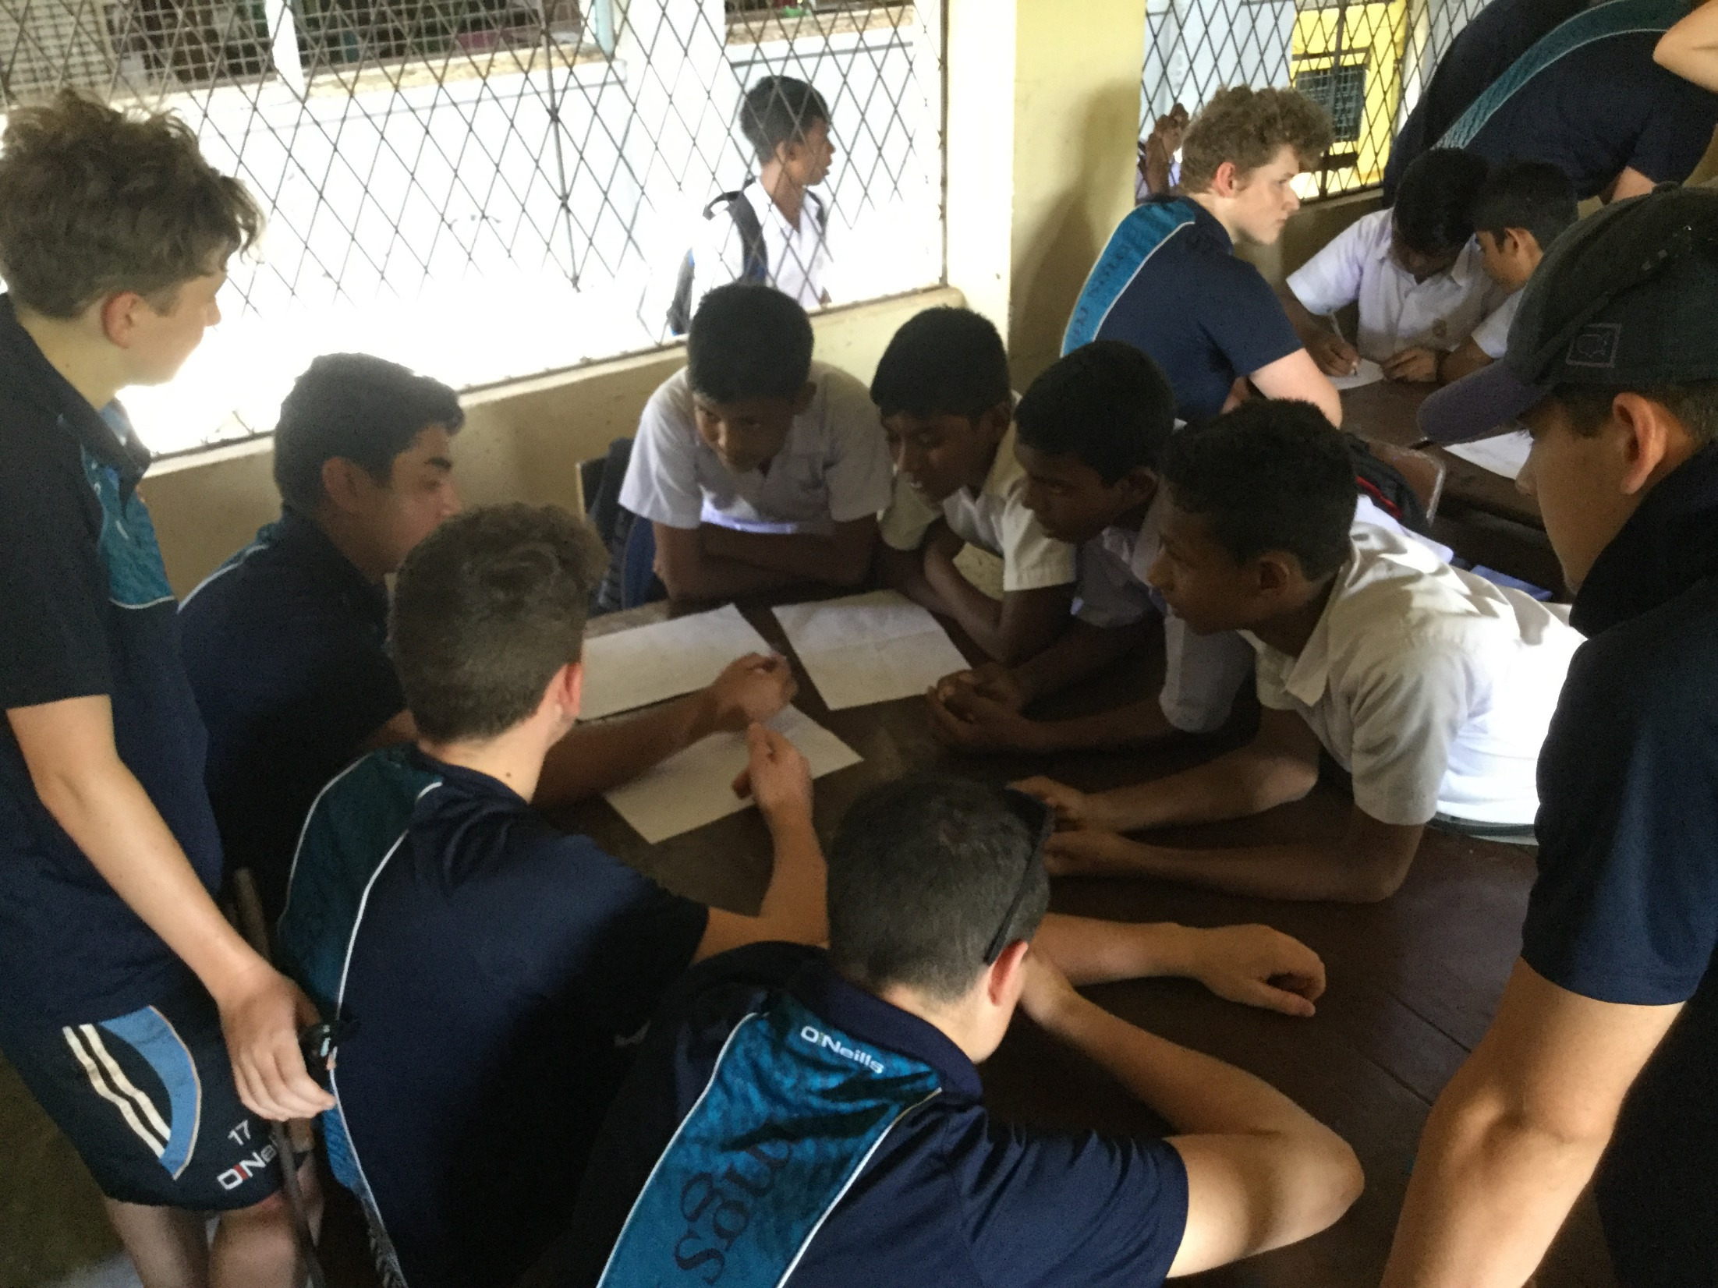
Improved confidence
By experiencing another country and culture, enjoying new foods and seeing different landscapes on a school trip, students can become more confident and open to new things.

Slide 16
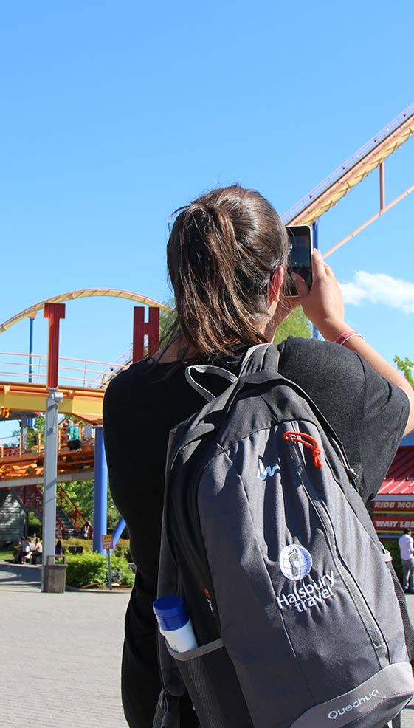
Who’s our tour operator?
30 years of experience
Halsbury Travel has been arranging school trips abroad for more than 30 years. The company was founded in 1986 by former teacher Keith Sharkey.
Keith’s passionate belief in the educational value of school trips is what drove the creation of Halsbury Travel. He wanted to make the process easier for teachers, so that more young people would have the opportunity to experience learning outside the classroom.
Financially protected
You’re financially protected by Halsbury’s ABTA bond and all the company’s flight packages are ATOL protected too.

Slide 17
Who’s our tour operator?
Committed to prioritising health and safety
Halsbury is also an Assured Member of the School Travel Forum, which demonstrates its commitment to prioritising the health and safety of its groups.
And it’s been awarded the Learning Outside the Classroom Quality Badge, which demonstrates its commitment to offering activities that are safe and beneficial to learning.

Slide 18
Any Questions?

